Slide 1
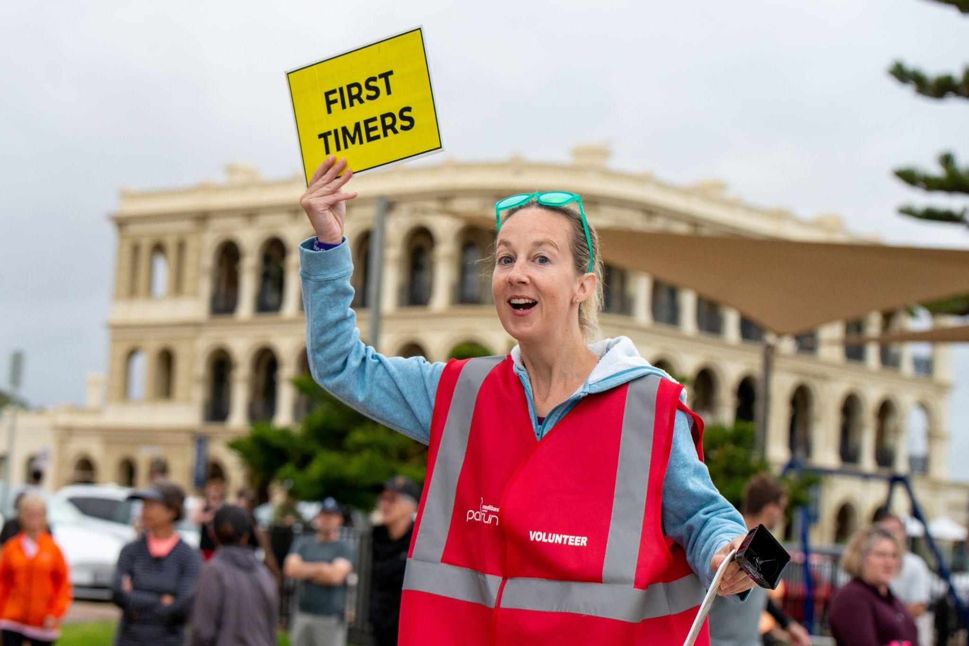

Slide 2
How to use this template presentation:
Save a copy of the entire presentation to your device
Edit using Google Slides, PowerPoint or Keynote
Don’t forget to “delete” “skip” or “hide” this instruction slide

Slide 3
Title and name of presenter
DATE

Slide 4
In the beginning…

Slide 5
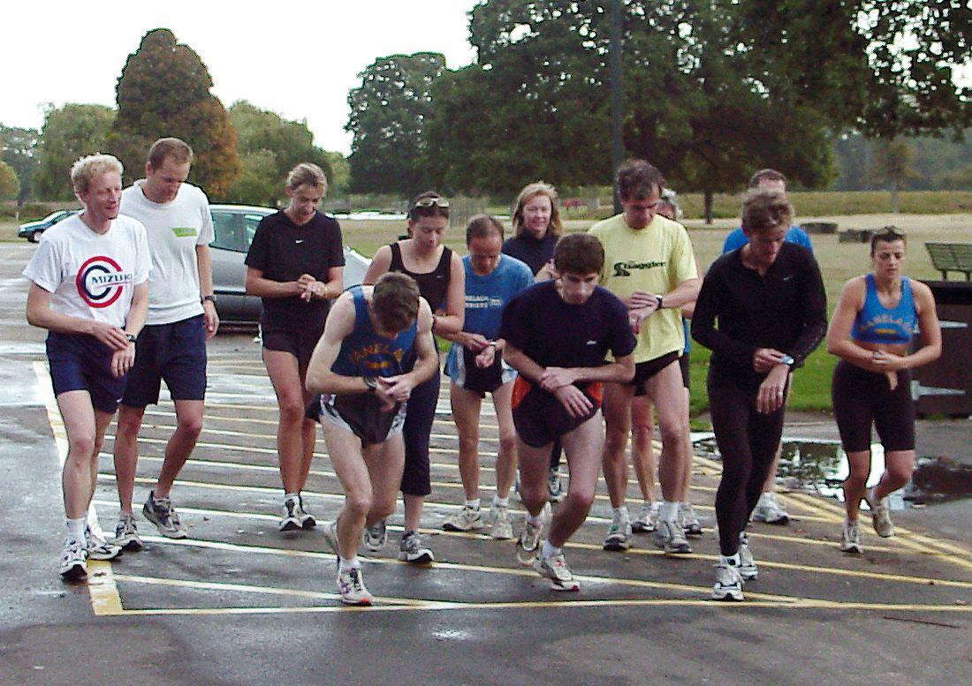
Notes:
This was the start line of the first parkrun in London in 2004: 13 runners supported by five volunteers followed by a coffee in the park cafe.
18 years later the model hasn’t changed.
What also hasn’t changed is the fundamental reason people come to parkrun.
Paul, who conceived the idea, was in his forties and going through a bit of a midlife crisis. He’d been sacked from his job, his marriage had broken down, and he’d suffered an injury that would keep him away from running club competitions for a couple of years. Paul had become disconnected from his neighbourhood and recognised he needed to bring his friends to him.
Paul decided to hold a free 5km event, open to everyone, every Saturday at 9am in his local park, with the caveat that people would join him for a coffee afterwards. Nobody could have imagined what happened next though…

Slide 6
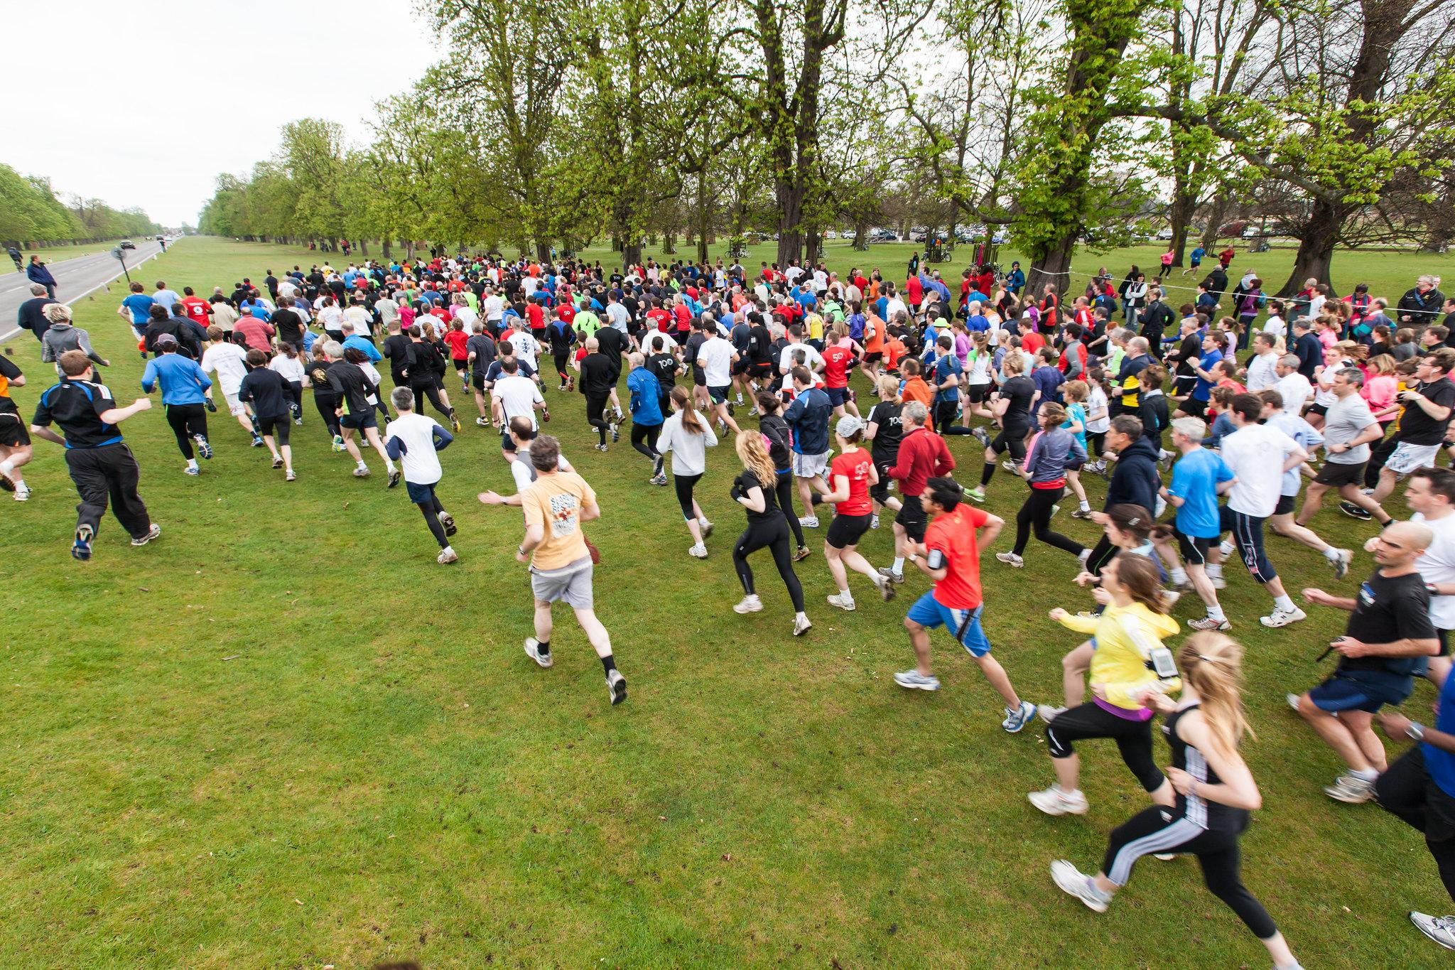
Notes:
Within two years more than 600 people were coming along to this one parkrun event.
Not just locals, but people from around the world who had heard about this simple idea and recognised that it could work in their community.
Paul agreed to support other communities to implement their own parkrun providing it was in line with the ‘parkrun principles’:
Free
5k
Every Saturday morning in a public open space
For everyone
Forever

Slide 7
parkrun now takes place within correctional settings

Slide 8
Since 2017, parkrun has been established in more than 35 custodial settings in Australia, UK and Ireland
More than 7,000 different people have walked/ran the event and more than 2,000 have volunteered
Participants have reported feeling supported and encouraged by their peers on a level playing field
Events are supported by prison physical education staff and officers
Participants can work towards milestones for taking part and feel a sense of achievement, belonging and ownership of their event
parkrun can be continued post-release.

Slide 9
What does a parkrun look like?

Slide 10
A beginner-friendly form of active participation - no time limits or ongoing commitment required
Each participant can take part at their own pace and gradually build up distance completed
Encouraging way to enjoy the outdoors in a social setting
Free, inclusive and all ages can participate
Participation including volunteering promotes a ‘feel good effect’
Fosters human connection and mental well-being
Notes:
Participation at parkrun including volunteering is a great way to meet new people, learn new skills, build confidence, have heaps of fun and is one of the best ways to improve your health and happiness.

Slide 11
How does parkrun differ in a correctional setting?

Slide 12
Due to space limitations, courses may be multiple loops
Results are recorded on the parkrun website only, participants are not permitted to wear watches
Registration and acquiring barcodes is administered centrally by prison staff
Volunteer rosters, event photos and reports can be printed for inmates who do not have online access
Real names are replaced with pseudonyms during registration
Notes:
We recognise that designing and implementing programs to assist with rehabilitation and contribute towards successful reintegration are a complex challenge and there is no silver bullet that can prevent re-offending. However our experience to date shows that parkrun’s inherent nature of incorporating physical activity, volunteering, education and skill development into our events does have a role to play

Slide 13
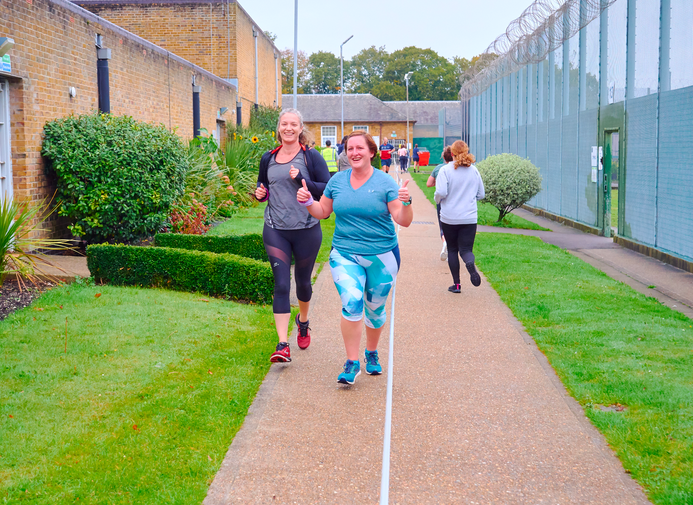
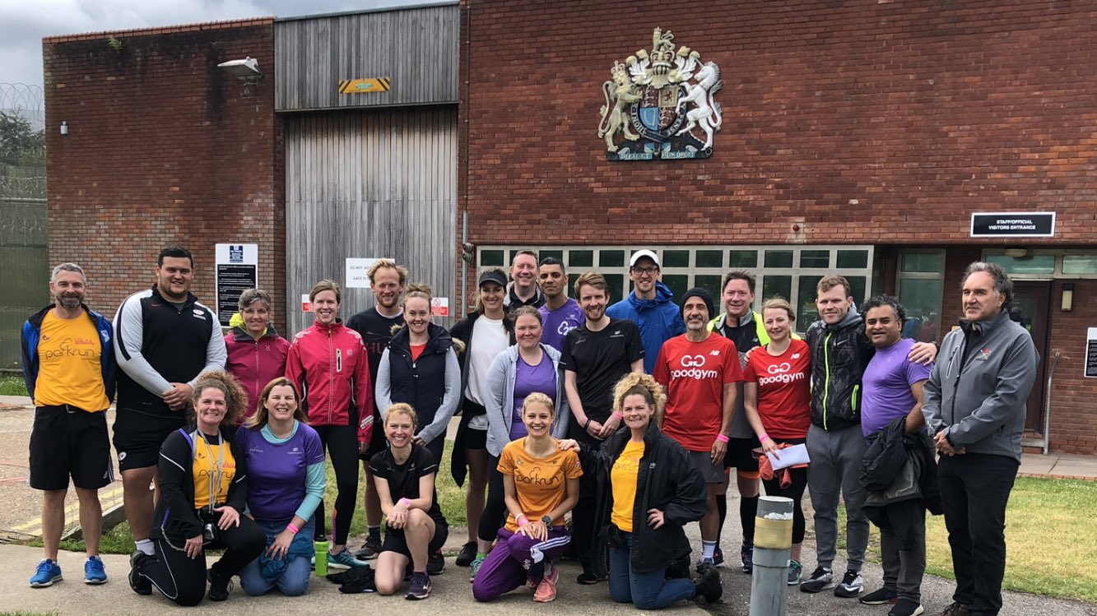
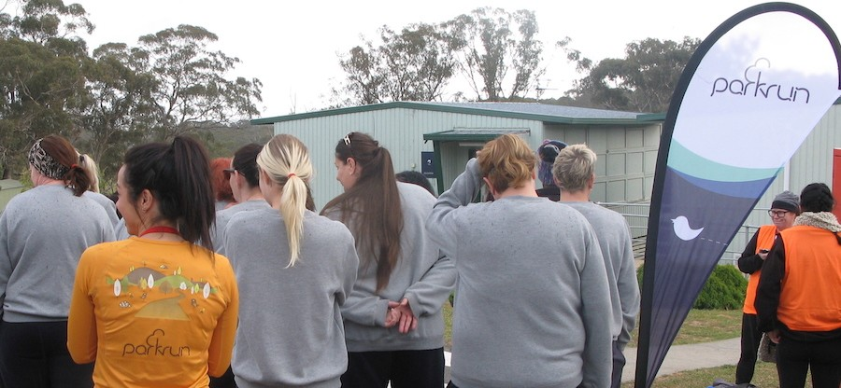
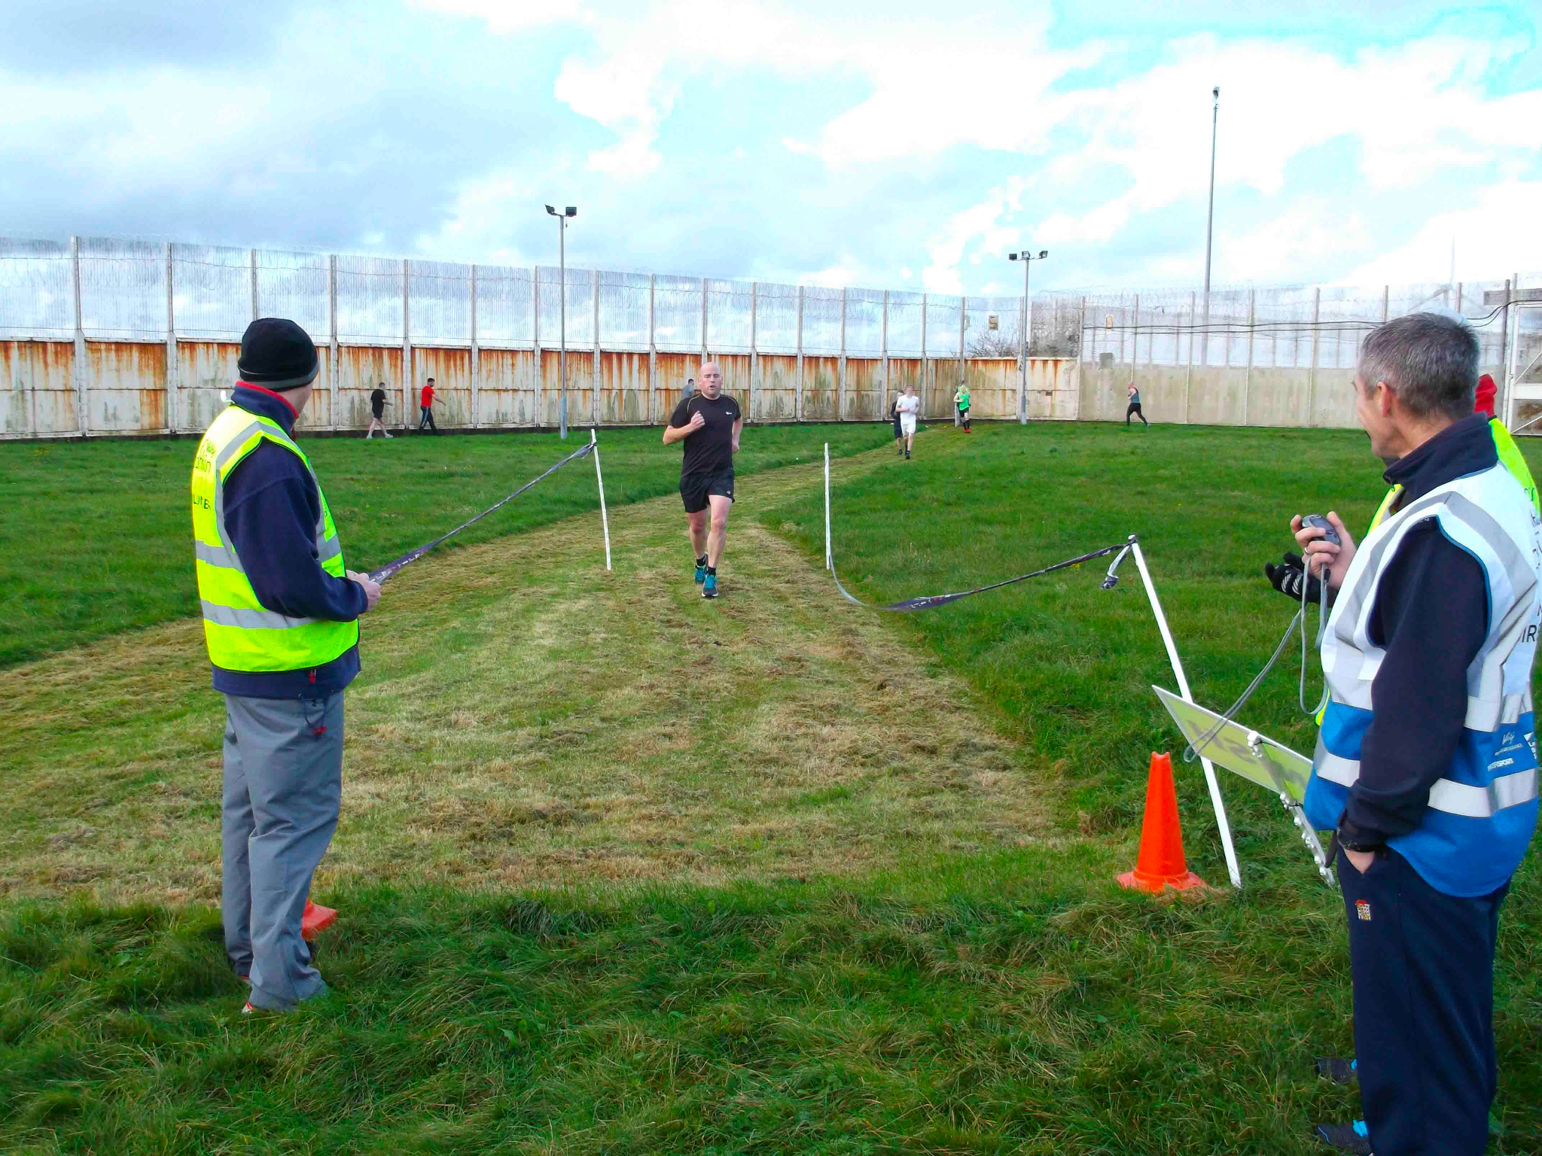

Slide 14
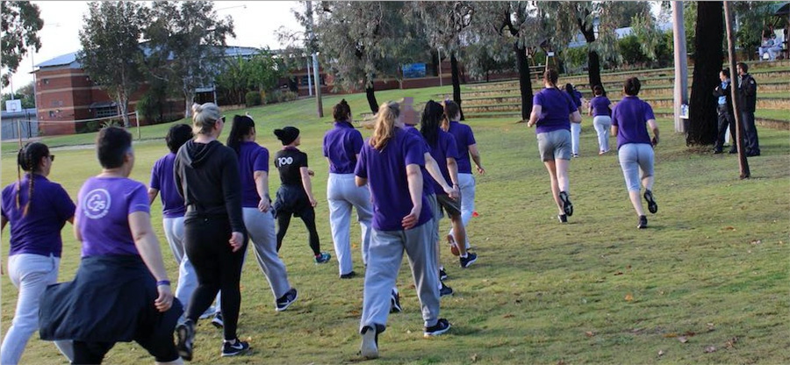
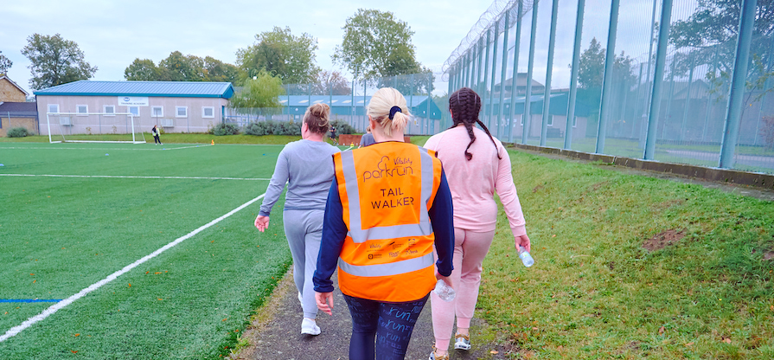
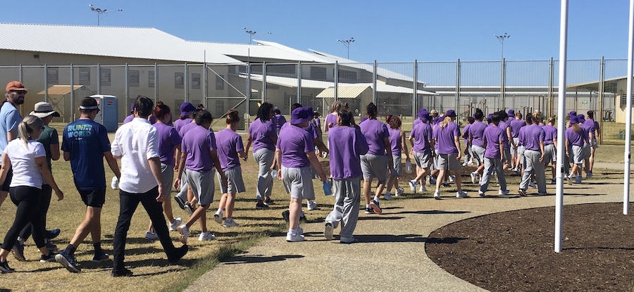
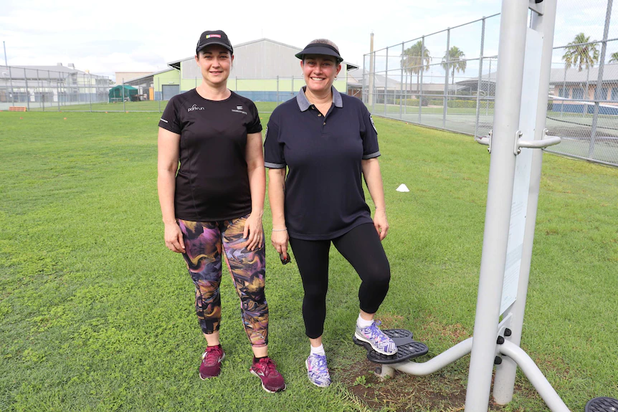
Walk run volunteer spectate
Notes:
You can participate as a walker, runner or volunteer or simply spectate and socialise

Slide 15
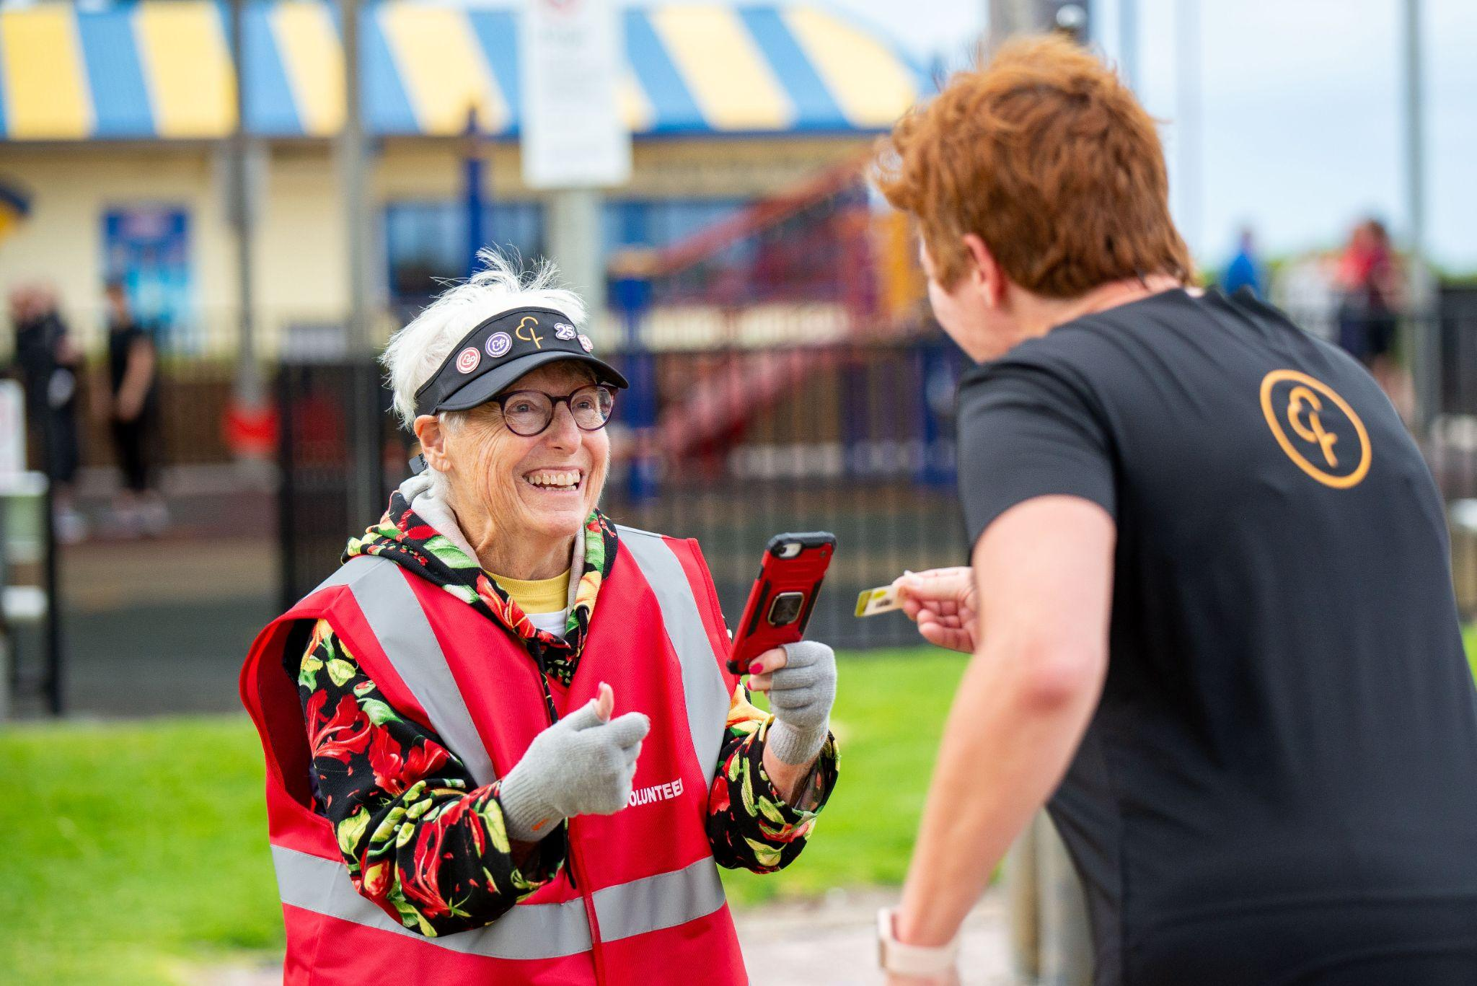
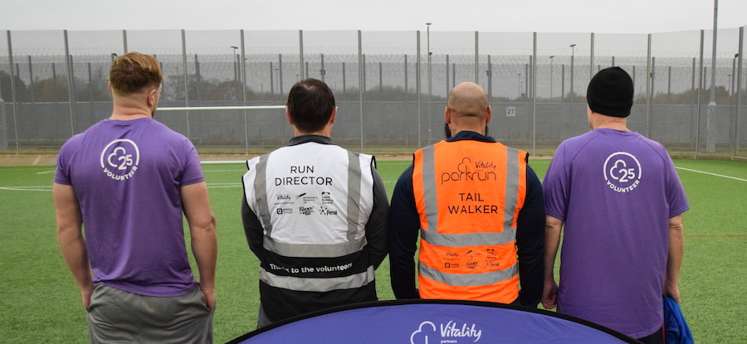
At the finish…
Notes:
parkrun guarantees everyone will have at least two personal interactions at each event.
When you cross the line you’ll be handed a finish token by a volunteer, and then another volunteer will scan your token and your personal barcode.

Slide 16
What are some of the benefits for holding parkrun within correctional centres?
Offers participants the chance to learn new skills through volunteering and feel a part of the community
Access to fresh air and physical activity can assist with anxiety and depression, improving overall health and well-being
A strong community means a safer environment for prison staff and officers
Talking with others and socialising provides support and a sense of empowerment and self-worth
Can link with medical services to signpost prisoners to parkrun as a form of ‘social prescribing’
Can integate with other programs such as education.
Notes:
Prisoners who have been introduced to parkrun whilst in prison in the UK and Ireland have spoken about how it has positively impacted their lifestyle choices in terms of diet, hydration and sleep and how this leads to better energy levels and moods and contributes to a more positive atmosphere within the prison.

Slide 17
continued…
Assists with developing healthy routines which will assist with their successful integration back into the wider community
Reducing reoffending is an important aim, as parkrun provides a welcoming, non-judgmental and positive community
Notes:
One participant who was on the start line of that first ever event at HMP Haverigg, credits parkrun for helping him carve out a new life outside of prison, he says “when you come out of prison, getting back on your feet is hard, especially financially. So, having something free, and regular, was amazing for me. I now have a full-time job and have been reunited with my son. I have a simple life which I am truly grateful for”.

Slide 18
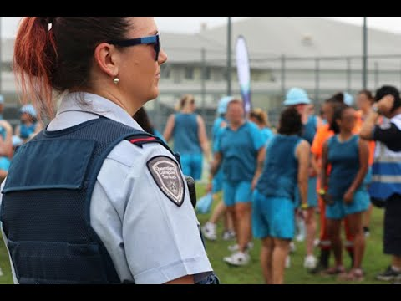
parkrun at the Brisbane Women’s Correctional Centre

Slide 19
Rewarding participation, not performance
parkrun is not a race
Participants can go at their own pace
Can do 5km or build up slowly
Can volunteer
Can earn credits towards volunteer or run/walk milestone shirts (starting with a “10” shirt for juniors)
Notes:
Milestone shirts can be earned through participation at parkrun, buth volunteering and walk/running. These range from 10 for juniors, right through to 500 shirts (see next slide)

Slide 20
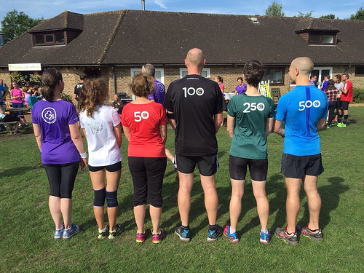
Notes:
Milestone shirts: Participation, not performance, has always been the focus of parkrun. These coveted shirts cannot be purchased - they can only be earned by turning up and walking, running and volunteering (explain the different shirts). Currently more than 2000 people around the world earn a milestone shirt every weekend.

Slide 21
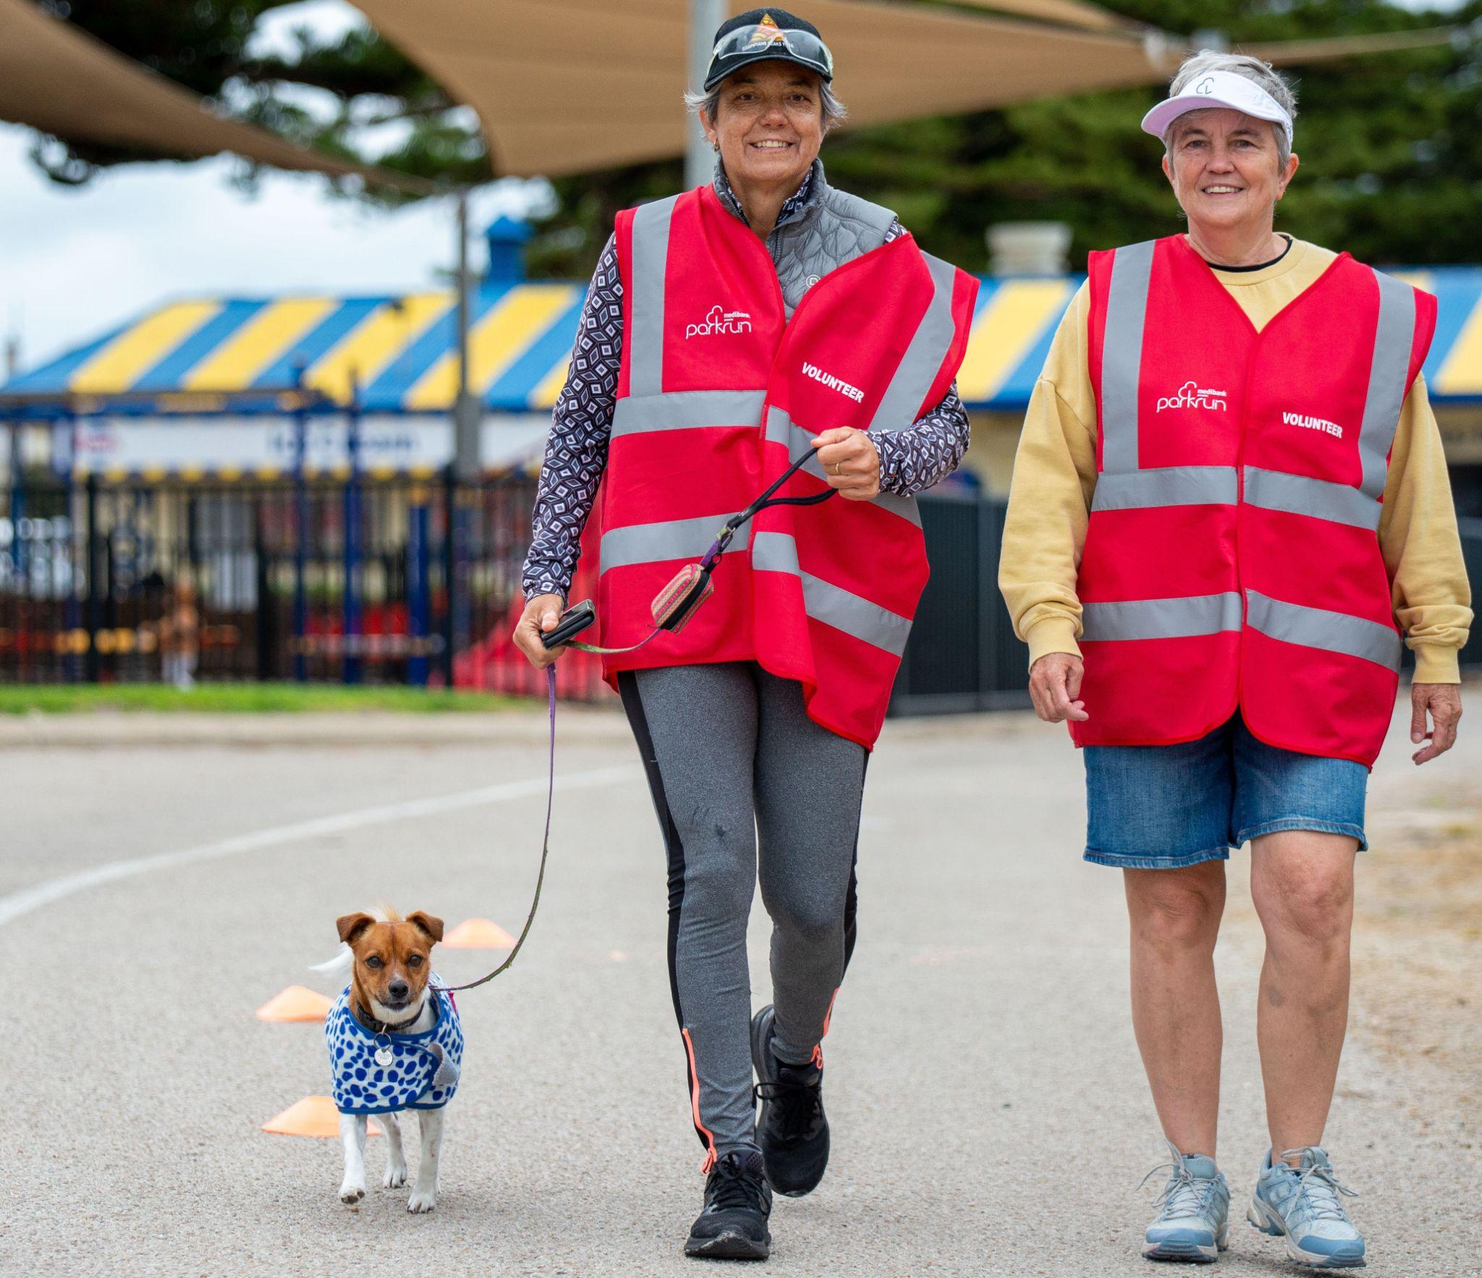
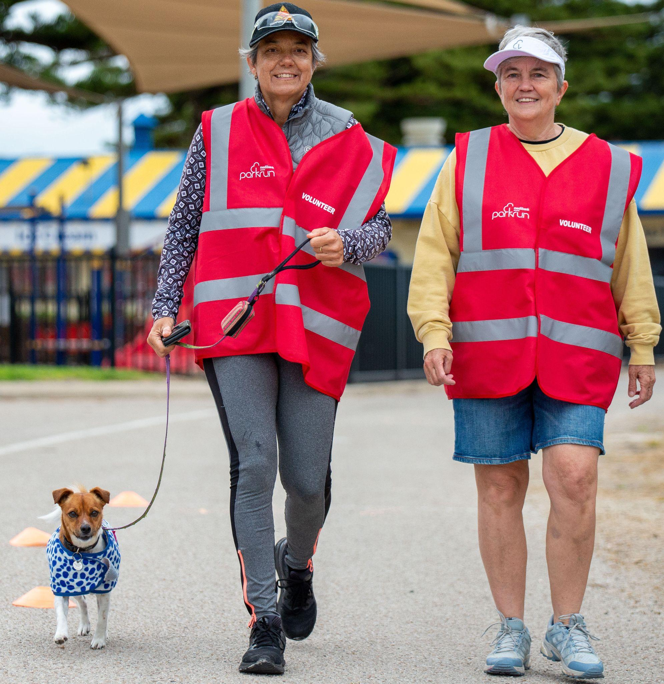
parkrun Australia’s growth
• More than 460 events every Saturday morning
• 850,000 individuals walking and running including 140,000 people volunteering
• 55,000+ walkers and runners each week
• 5,000 volunteers each week

Slide 22
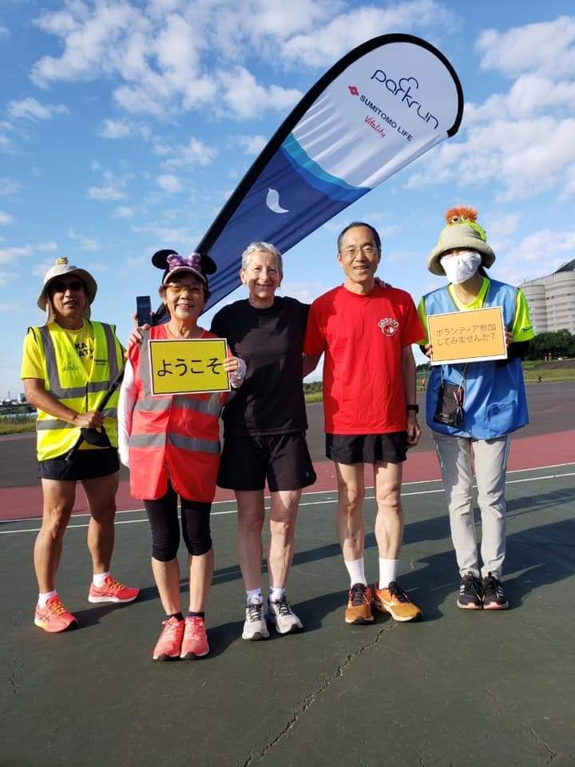
A global phenomenon
• 22 countries
• 2200 weekly events
• 260,000+ weekly participants
• 6 million+ have taken part worldwide
• 350,000 weekly participants
• 5 million+ taking part worldide
• Will double in size by 2023

Slide 23
How has parkrun already contributed to public health and well-being?

Slide 24
2019 parkrun Health & Wellbeing Survey
After participating at parkrun…
91% of all respondents reported a sense of personal achievement
89% reported improvements to their fitness
85% reported improvements to their physical health
79% reported improvements to their happiness
69% reported improvements to their mental health
Notes:
To really understand the impact of parkrun on people’s health and wellbeing, in 2019 a study was conducted of more than 60,000 parkrunners.

Slide 25
Interested in bringing parkrun to a correctional facility?
support@parkrun.com
Notes:
We invite anyone who works in a correctional facility to get in touch with us to find out more about introducing parkrun. Please email support@parkrun.com

Slide 26
[your contact details]

