Slide 1
Safe Strides
Survey
May 2026

Slide 2
Background
parkrun Australia is working in partnership with the New South Wales Office of Sport on a public safety campaign in regional and rural locations.
This campaign is specifically about safety whilst running.
This study explores what role parkrun plays in the safety of women runners.

Slide 3
Survey aims
Better understand the attitudes and experiences of women runners in New South Wales outside of the Sydney Metropolitan Area;
Educate the public about the steps many women take in preparing to go for a run;
Promote parkrun as a safe and welcoming space for women to participate in physical activity.

Slide 4
The survey
Online survey: March 2026
Respondents:
439
Responses
15,000
Selection criteria:
Registered in AUS
Aged 18 +
Finished parkrun in the last 12 months at named events
8,000
Invites sent
5%
Response rate

Slide 5
The sample
439
Responses
Characteristics
80% of women were over 45 years old
69% had finished over 50 parkruns as a runner/walker
23% had volunteered over 50 times
1% Aboriginal, 0% Torres Strait Islander
21% had physical or mental health conditions or illnesses

Slide 6
Headline findings

Slide 7
69%
61%
of women surveyed only run in daylight hours
of women surveyed said they avoid running when it’s dark

Slide 8
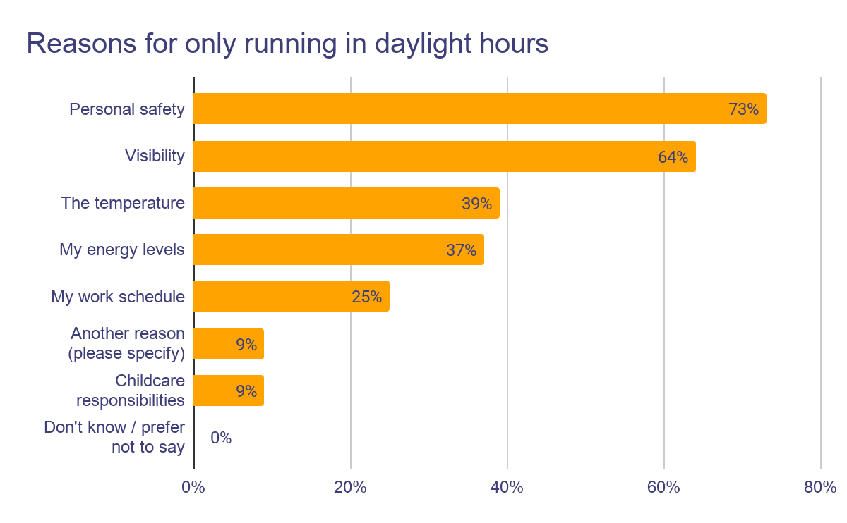
…due to personal safety and visibility
Why do you run at that time of day?
73% of those saying they only ran in daylight said this was because of personal safety
64% said it was because of visibility

Slide 9
95%
of women surveyed said safety is a reason they do not run in the dark
Of which 65% said safety is a major reason
30% said safety is something of a reason
Only 5% said safety is not a reason to run in the dark

Slide 10
90% of women surveyed feel safe running alone in their neighbourhood during daylight hours…
…while 48% say they feel safe running alone in their neighbourhood when it is dark.

Slide 11
62%
of women surveyed said they have felt scared running alone in their neighbourhood
Of which 59% said they sometimes feel scared
2% said they feel scared most of the time
1% said they always feel scared
34% say they never feel scared when running alone in their neighbourhood

Slide 12
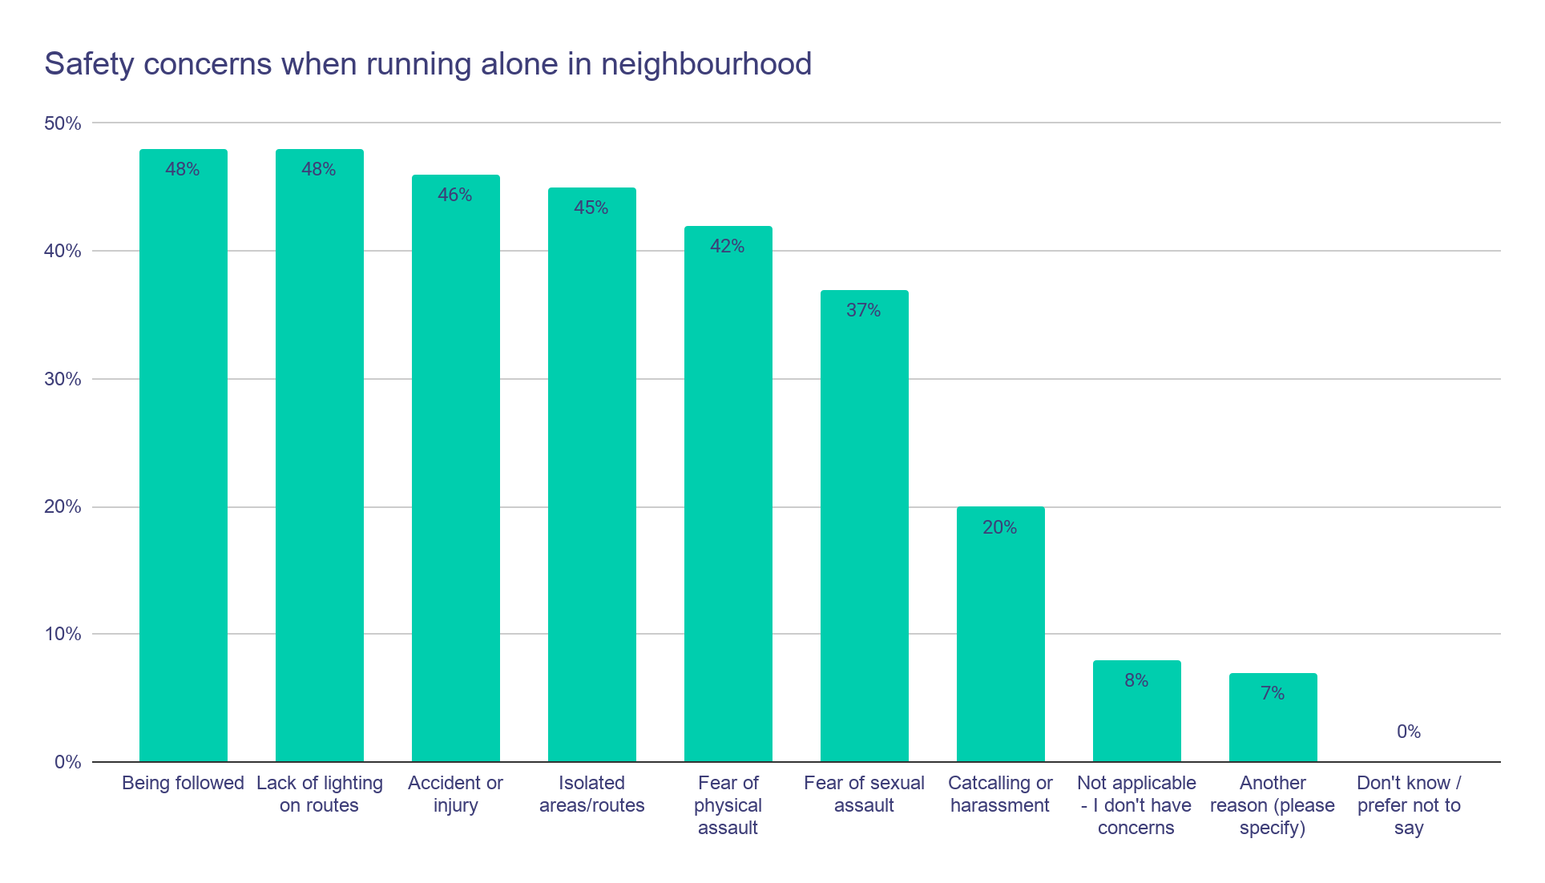
Safety concerns cover a mixture of physical safety threats, environmental risks and harassment
Traffic, no footpaths, dogs and other wildlife (snakes, kangaroos) are also concerns for the women surveyed

Slide 13
73%
of women surveyed said running in a group makes them feel safer
Of which 62% said a lot safer
11% said a little safer
7% said running in a group makes no difference to how safe they feel

Slide 14
63% of women surveyed said their family is concerned about their safety when they go running
…with 31% saying their families are not at all concerned about their safety when running.

Slide 15
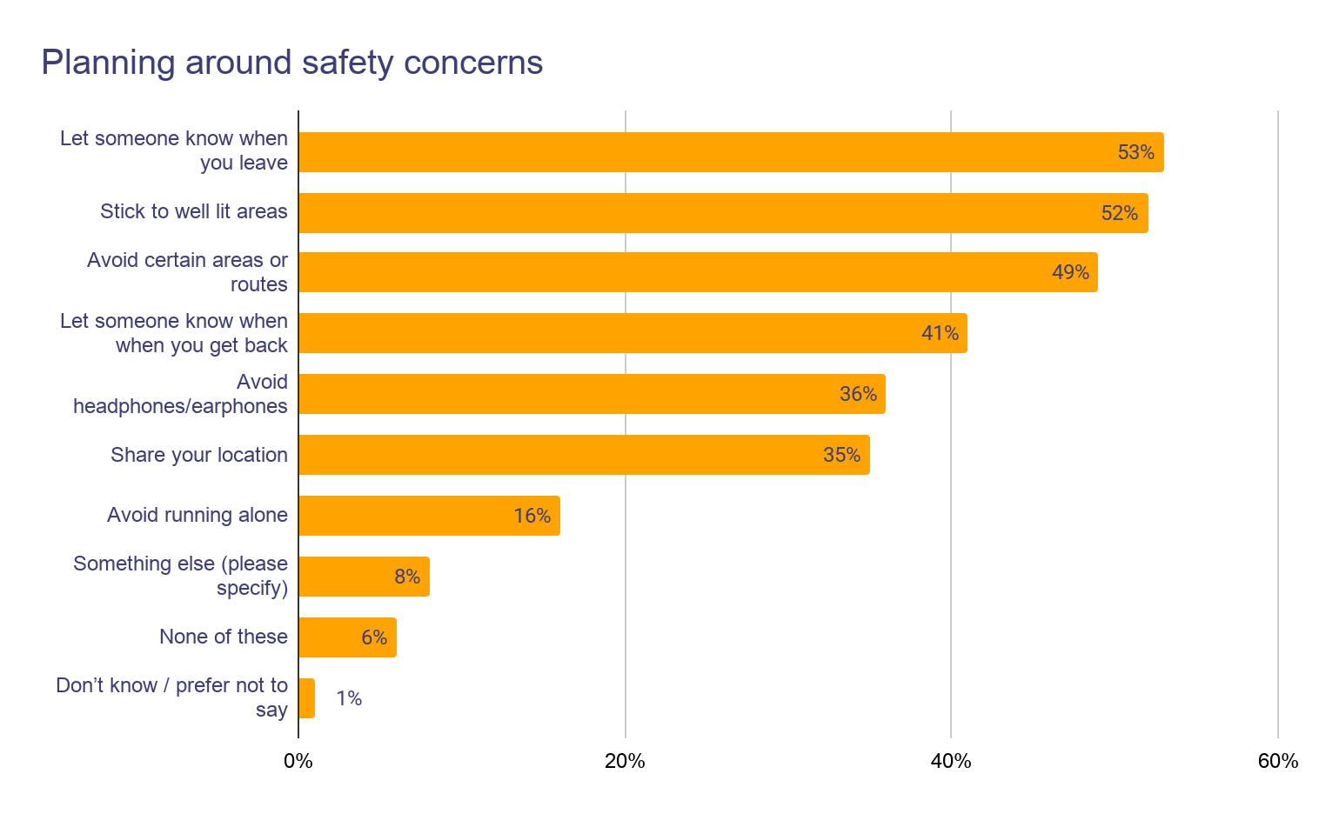
Women plan their runs around their safety concerns
Much of the preparation involves:
Letting people know when they leave/get back
Planning their route carefully to avoid certain areas and ensure it’s well lit

Slide 16
Women plan their runs around their safety concerns
Other things women do because of safety concerns:
Take their dog
Only run at parkrun
Only plan runs in daylight
Keep distance from groups / men
Take phone
Avoid isolated areas
Avoid noise-cancelling headphones

Slide 17
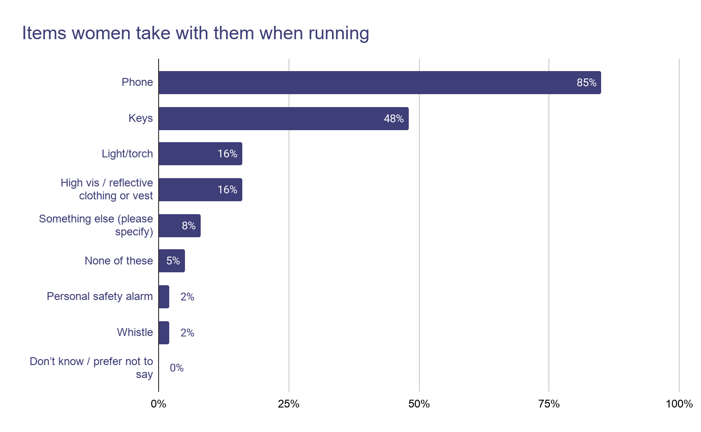
Most will carry their phone. A few carry personal alarms/whistles
Women also take their dog, sports watch (emergency call) and ICE details. pocket knife (n=1)
vinegar spray (n=1)
snake bandage (n=1)

Slide 18
96%
of women surveyed said they feel safe when running at parkun
Of which 90% said they feel very safe
6% said they feel generally safe
2% said they feel unsafe when running at parkrun

Slide 19
Reasons for feeling safe at parkrun included….
Safety in numbers
Volunteer presence
Social connection and community
parkrun format
Group running format
Lots of women
You’re never alone
“I feel like I’m being looked after”
Tailwalkers - knowing someone is always behind is “a little extra comfort”
Encouragement
Friendly, kind
Helpful
Like-minded people
Look out for each other
Daylight time
Well organised
Course checked for hazards
Separate from traffic
First aid/ Defibrillator

Slide 20
“Wonderfully friendly sense of community, well marked routes, amazing volunteers, the one time I fell someone helped me up then ran alongside me for the remainder of parkrun, then insisted the finish area volunteers check me out at the finish. We all look out for each other at parkrun.”

Slide 21
“I generally feel safe running in my neighborhood because I know the area well and have chosen I route that I consider safe (lots of people around). When I travel and want to go for a run in an unfamiliar location I prefer to go to parkrun than run an unfamiliar route because I feel safer. So I am more likely to attend parkrun when I am away from home.”

Slide 22
Reasons for feeling unsafe at parkrun
The women surveyed generally feel safe running at parkrun due to the supportive environment and event format, though some highlighted specific incidents that affected their sense of safety. Feedback was mostly positive, with few negative experiences.
Dogs
Photography
Technical course - risk of falls
Buggies
Crowding
Data & privacy
Aggressive fast runners (men)
Unsolicited comments
“very wary of the dogs at parkrun”
“I feel more comfortable with less participants. With 800 people, I feel overwhelmed, so I search for other park runs with less people.”

Slide 23
95%
of women surveyed said they never feel scared when running at parkun…
Compared to 62% who said they felt scared when running alone in their neighbourhood

Slide 24
81%
of women surveyed said running at parkrun makes them feel safer than running in their neighbourhood
Of which 62% said they feel a lot safer at parkrun
19% said they feel a little safer at parkrun
17% said running at parkrun makes no difference to their feeling of safety

Slide 25
63% of women spend a similar time preparing to run at parkrun as they do a run in their neighbourhood
…for those that take longer preparing for parkrun (18%) it’s generally because of travel time
…for those that take less time preparing for parkrun (also 18%) it’s because they can go without making extra arrangements (like planning a route, letting people know where they’re going, less need for hydration etc)

Slide 26
47%
of women surveyed said they have formed friendships with people at parkrun who they run with during the week
“The friends I have made at parkrun have opened up a whole world of trail running that I would never have been able to do on my own. We have a bunch of women who go out on trails most weekends (parkrun Saturday, trail on Sunday). There is safety in numbers, and the support and lasting friendships are priceless.”

Slide 27
We asked women if there was anything else they wanted to tell us about their experiences of safety while running

Slide 28
Common themes
Solo safety concerns and gender inequality
Sense of unease when running alone or in the dark. Extra “safety work” required by women to address safety concerns (harassment, assault and unwanted attention) including only running in daylight, carrying devices, notifying someone of their whereabouts and sticking to familiar routes.
Environmental hazards
Concerns about hazards in the surrounding environment including animals (mostly dogs, but also swooping magpies, snakes), lack of footpaths, uneven surfaces, overgrown bushes, homeless sites, vehicles, bikes, electric bikes and scooters.
Value of running in a group
Running with others (people and/or dogs) preferred over running alone and create a buffer against threat. People perceive safety in numbers. Benefits of parkrun widely cited here - women feel safe at parkrun and attribute this to the supportive community, volunteer presence and large numbers of people.
Underpinned by a desire for freedom
“I would love to be able to dash out any time of day, night, any trail or path and feel safe.”

Slide 29
Quotes: safety
“It is sad that as women, we have to always be thinking of our safety while running. My husband goes for a run in the dark in the morning with no fear, something I could never do.”
“I’m not so worried about other people and more worried about trip and fall hazards and sections where there is no footpath and I’m forced to run on the road. Connected, well maintained, well lit footpaths, with safe road crossings and separated cycle paths would be ideal. Using that perforated footpath material instead of concrete would also reduce impact injury.”
Minority viewpoint: no concerns whatsoever
“Frankly, I have never thought about it. I have never felt unsafe, but then, I don't take risks either.”
“Always feel safe”

Slide 30
Quotes: parkrun
“I always refused to go running because I felt unsafe. Now I get excited for parkrun and it's the safest I've ever felt generally when being in the community. It's such a good vibe and everyone seems really supportive. Thank you for providing a safe space for exercise”
“I feel parkrun provides an invaluable safe space for people to exercise regardless of their fitness level. It also provides a space for like minded people to meet and develop a network to encourage safe small group running and walking at other times in the week.”
“It's nice to run in a park, not so safe when its quiet, so parkrun is perfect”
“parkrun is a great way for women to run safely and without fear of something bad happening.”

Slide 31
Summary
Over half of the women surveyed have felt scared running alone in their neighbourhood. Half experience persistent safety concerns about running alone in the dark - feeling vulnerable and taking extra precautions when planning their running.
These extra precautions or ‘safety work’ includes running only in daylight hours, carrying devices, using familiar routes, and letting someone know their whereabouts. This safety work seems second-nature to many women.
Women’s safety whilst running is about personal safety (physical threats from people) and environmental factors (lighting, infrastructure).
Safety concerns can limit participation - with some women choosing to run with others or within organised groups.
Four out of five women surveyed said they felt safer running at parkrun than in their neighbourhood. parkrun alleviates some of the burden of ‘safety work’ and almost 100% of women surveyed felt safe at parkun.
Women feel reassured by the familiar format, volunteer presence and community support at parkrun.

Slide 32

Meaning for parkrun
parkrun is already part of the solution
Women feel significantly safer at parkrun than running alone - our format, volunteers, and community are making women feel safer.
Safety is a barrier to participation
For some women, safety concerns limit when, where, and whether they run at all. parkrun has an opportunity to reduce that burden and bring more women into regular running. We need to amplify parkrun as a safe space for women.
Community and presence are our strongest assets
Volunteers, the friendly community, and a structured format are what make women feel safe. We help reduce some of the ‘safety work’ for women runners.
Safety beyond parkrun
The majority of safety concerns happen outside of parkrun in everyday running. This raises a question about what role parkrun could play in supporting women beyond the Saturday morning event e.g., campaigns, allyship.

Slide 33
Acknowledgements
With thanks to the women who participated in this survey, and the NSW Office of Sport for funding this projet.
“Thank you for asking. This survey will matter.”

Slide 34
Thank you.

